Slide 1


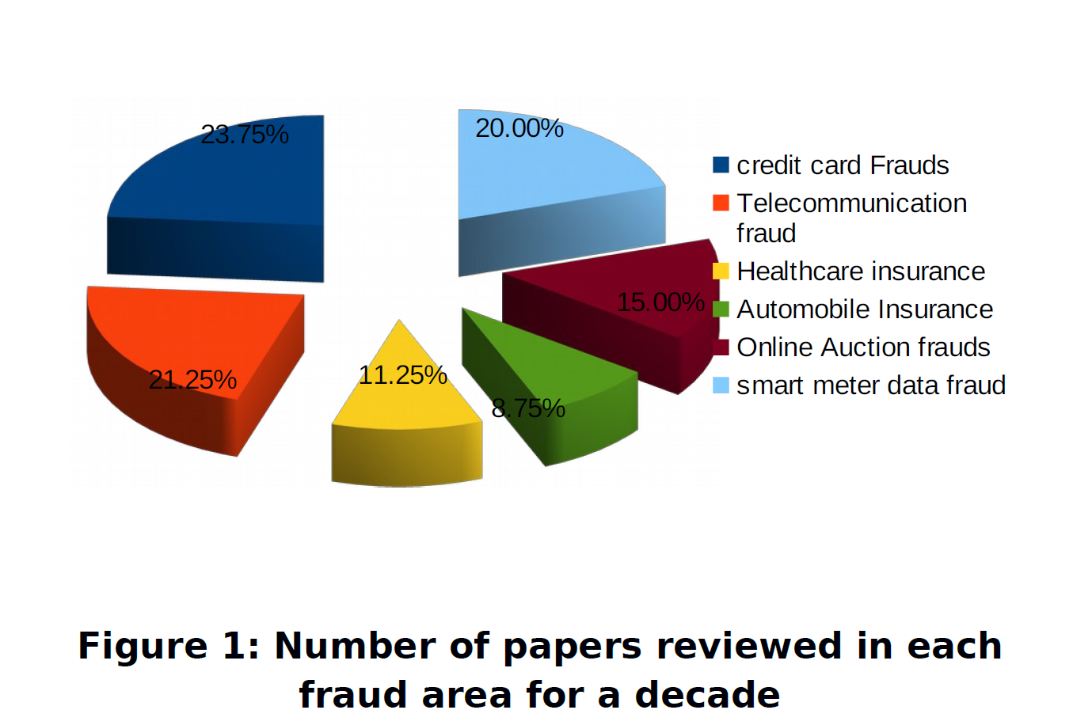
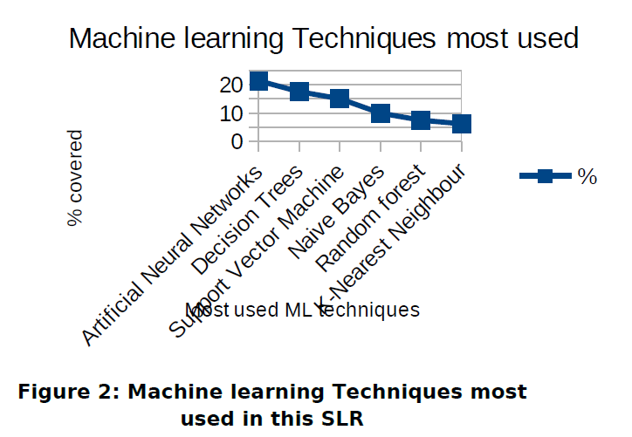
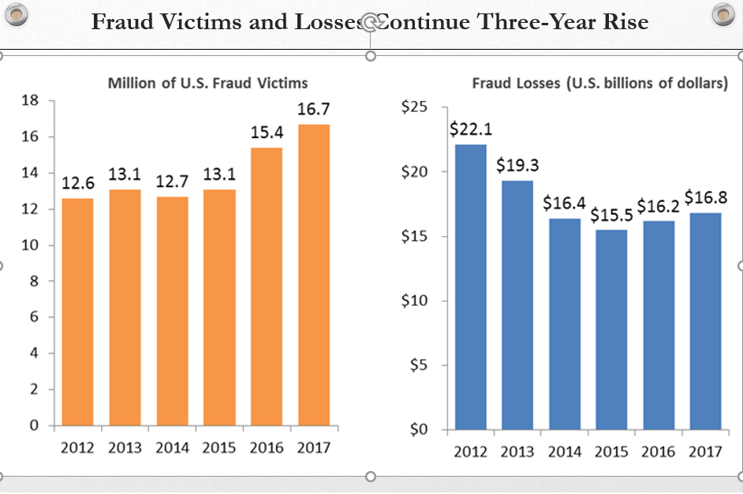
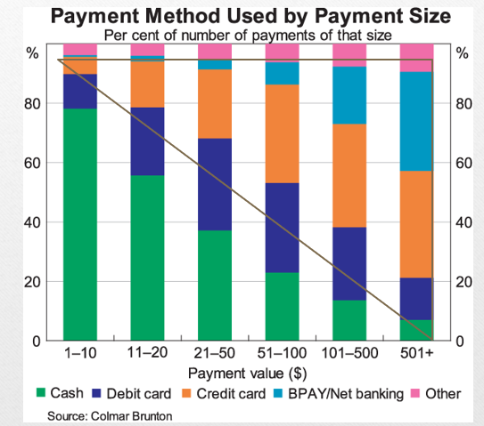
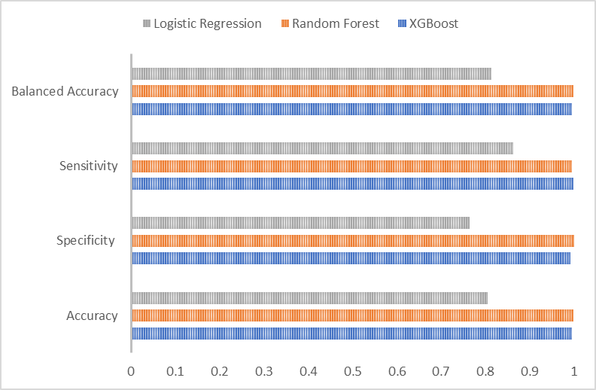
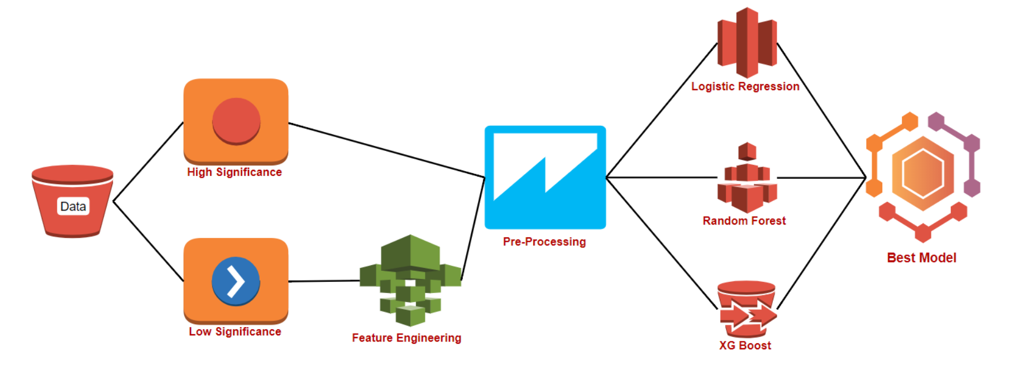
Credit Card and Mobile Fraud Detection using Supervised Learning Algorithms
Deepika Jindal; Yash Sharma; Himanshu Premchandani, Nipun Diwan; Matthew A. Lanham
Purdue University, Department of Management, 403 W. State Street, West Lafayette, IN 47907
djindal@purdue.edu; sharm364@purdue.edu; himanshu@purdue.edu; ndiwan@purdue.edu; lanhamm@purdue.edu
Abstract
This study is novel because we predict fraud in mobile transactions and use down sampling along with various top models`
Results
In this study, we are trying to analyze the pattern of fraudulent transactions by making use of different modelling techniques and using the results obtained from our study to predict and prevent similar fraud cases in future We performed feature engineering to develop new variables that helped us in our prediction. We have used three different model: logistic regression, random forest and XG boost for training our dataset and measured the performance of each model in terms of balanced accuracy, sensitivity and specificity.
We observe that the best results are obtained using XGBoost and random forest.
It can be seen from the results summary that none of the models overfit the data if we follow the empirical rule of 15% difference allowance in the train and test data. Based on the specificity results it can be said that 99.72% of the fraud transactions can be identified through the model developer. This translates to an estimated saving of $219,000 for a typical bank branch based on estimated daily transaction of $300,000 at a branch..
Introduction
Figure 2:. Literature review summary by method used
According to latest report from Javelin Strategy & Research, “Around 15.4 million consumers were victims of identity theft or fraud last year and the total fraud costed whooping $16 billion”. It is therefore paramount to enhance the fraud detection mechanisms. Our objective is to predict future fraudulent activities with maximum accuracy using the available data.
Relevance:
Digitalization in the financial sector has made it more vulnerable towards frauds
Increase in number of mobile and online transactions
Amount of Literature
Questions to be asked?
Which sampling method works better for predicting and modeling of fraudulent activity
Which modeling technique works best for fraud detection?
Does the algorithm for mobile transactions and credit card transactions differ?
Figure 5. Model Evaluation
Methodology
To predict fraud transaction several methods have been used that include recognizing customer spending behavior, tracking network data, using advanced modeling techniques, using biotechnology-based methods etc. In this experiment we first do a down sampling to create an approximately 50:50 split of fraud and non-fraud transactions.
Figure 1) .a: Fraud Trends in past , b: Modes of payment
Figure 3: outlines our study design, starting from data collection, data cleaning, data pre-processing, feature creation and selection, model/approach selection and model assessment/performance measures.
Figure 5. Model Evaluation basis specificity, sensitivity, balanced accuracy
Balancing of Data 50% down sampling to train data
Parameter Selection using various models random forest, logistics regression, XGBoost
Parameters creating using Feature Engineering- Time, date, differential
Removing multicollinearity and collinearity
Training the model using 5-fold cross-validation
Exploratory Data analysis
Model selection using Specificity, sensitivity, balanced accuracy etc
Conclusions
From the above research and experimentation it can be concluded that:
Random forest performed the best amongst the three.
Logistic Regression performed the worst amongst the three.
Random forest is most useful model with data spread over a very high range.
A typical branch can save approximately $219,00 in year through the implementation of our model and the cost of deploying such as application has become inexpensive with advances in technology. The saving in fraud get multiplied if the model is maintained at central place and multiple branched connect with it.
Literature Review
Credit card and mobile payment fraud detection has drawn a lot of research interest and a number of techniques, with special emphasis on techniques such as Logistic regression, Random forest, XG Boost, data mining and distributed data mining have been suggested. Various methods for sampling data for unbalanced data has been suggested.
Figure 4. Flowchart of steps in the process
Acknowledgements
We thank Professor Matthew Lanham for constant guidance on this project.

